Slide 2
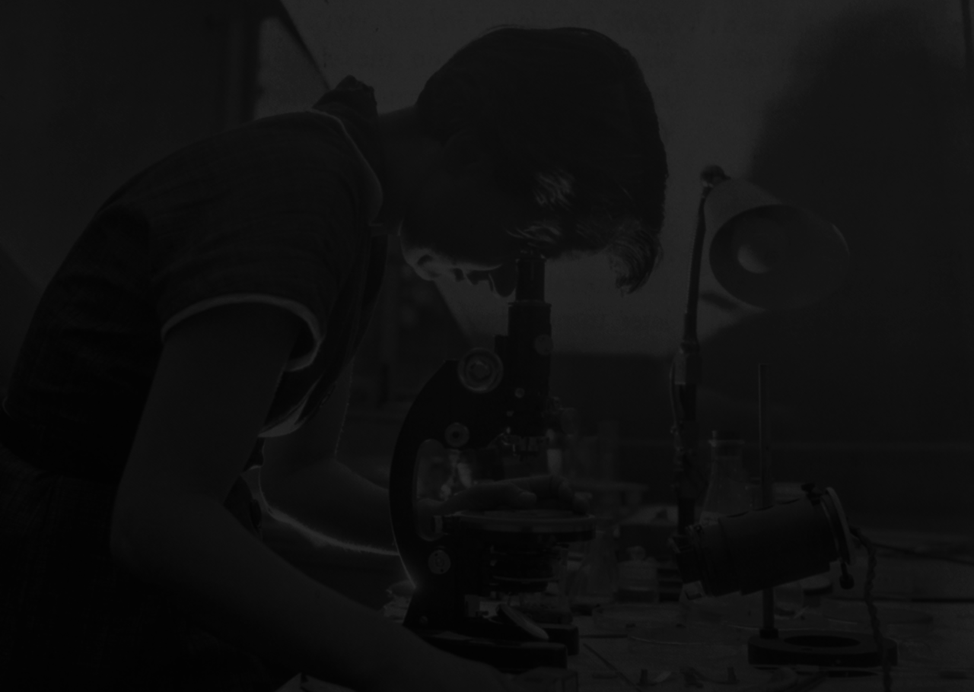

Slide 3
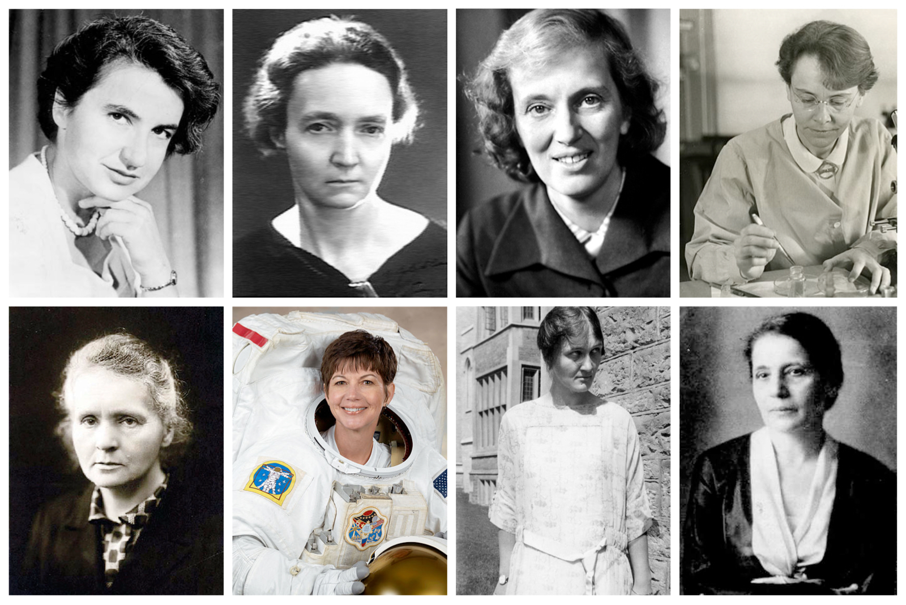
The Study of Science and Health Communication
How have women in science and medicine
been portrayed in:
their fields’ disciplinary histories?
the broader scientific community?
mainstream media and public discourse?
Notes:
Individual clicks for bullet points

Slide 4
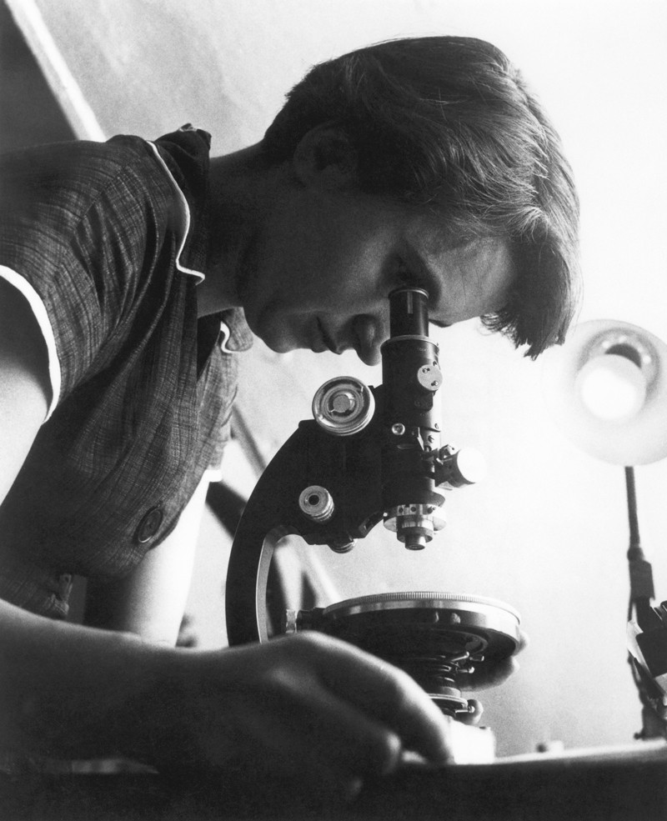
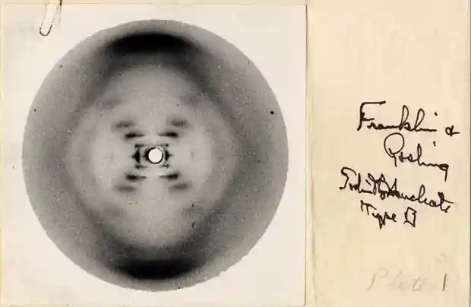
Rosalind Franklin’s
Contributions to Genetic Science

Slide 5
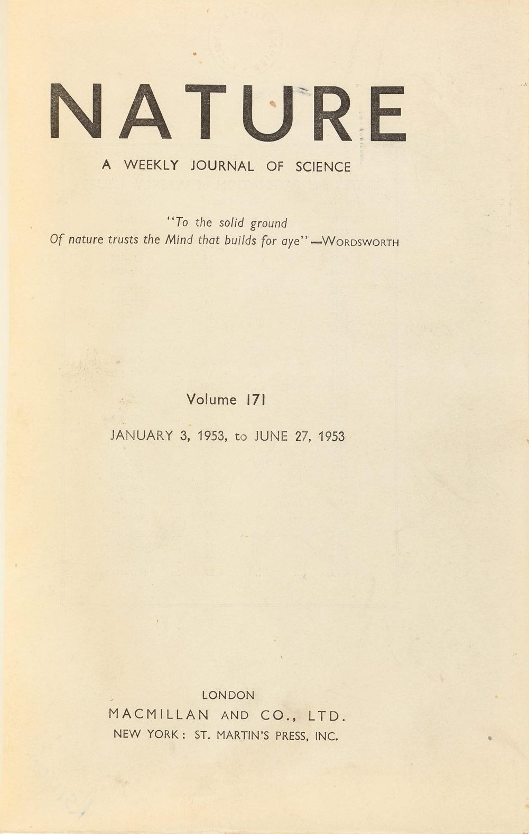
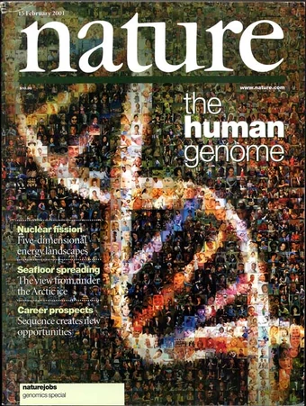
Nature’s Coverage of Franklin and DNA
Original Reports
published in 1953
Post-humous Coverage
1958-2015

Slide 6
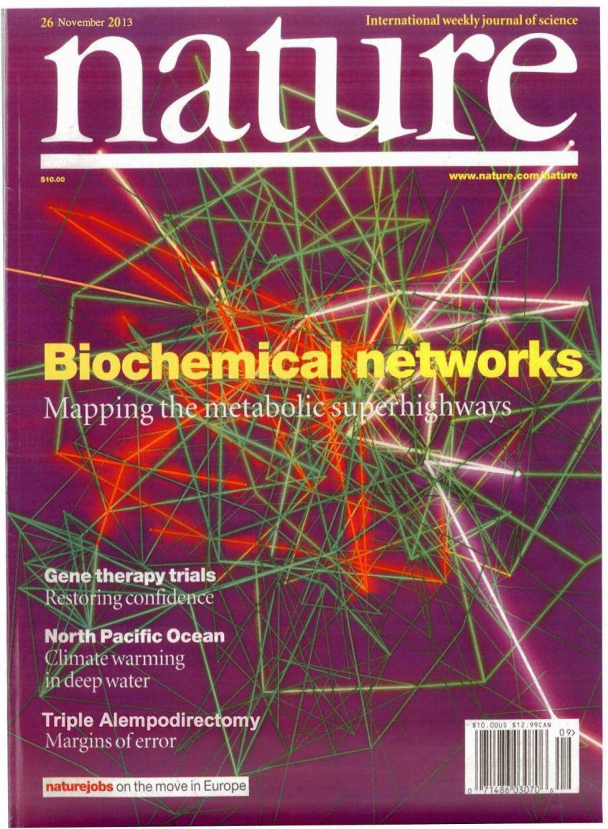
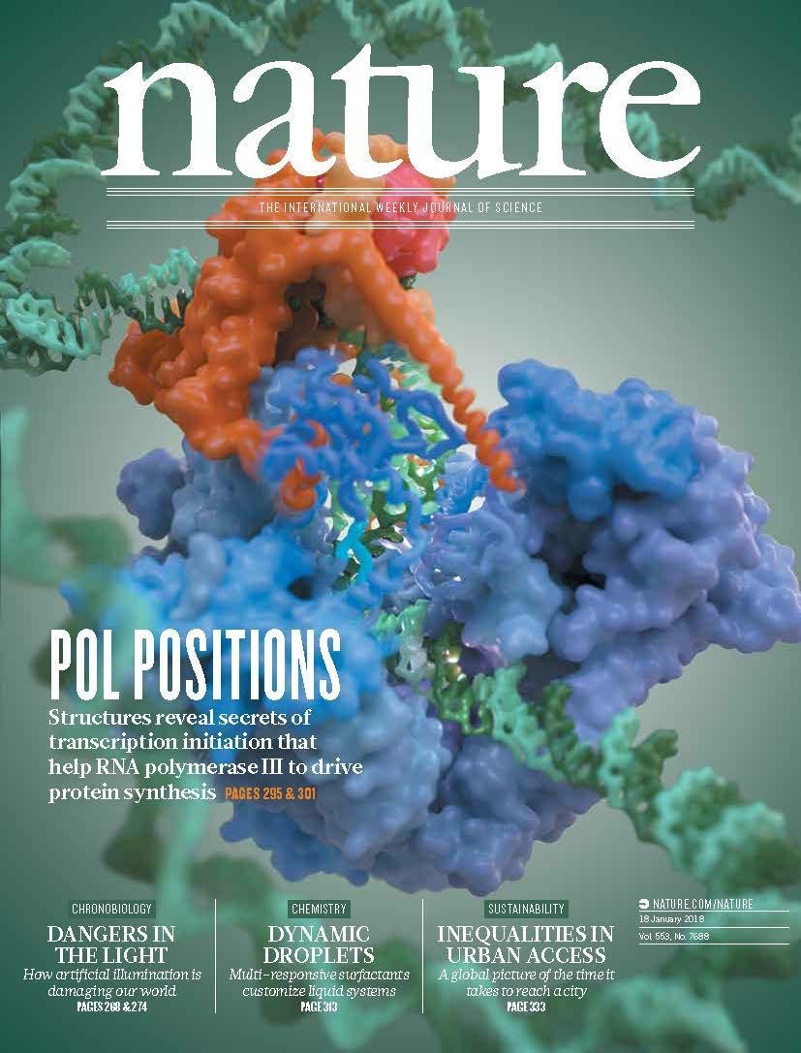
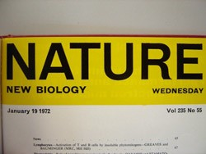
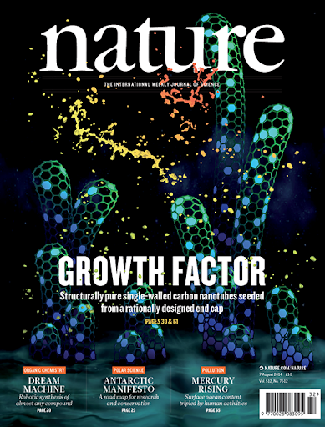
68 Nature pieces from 1958-2015 including:
22 reviews
12 commentaries
9 feature articles
8 short reports
8 letters-to-the-editor
5 editorials
4 obituaries

Slide 7
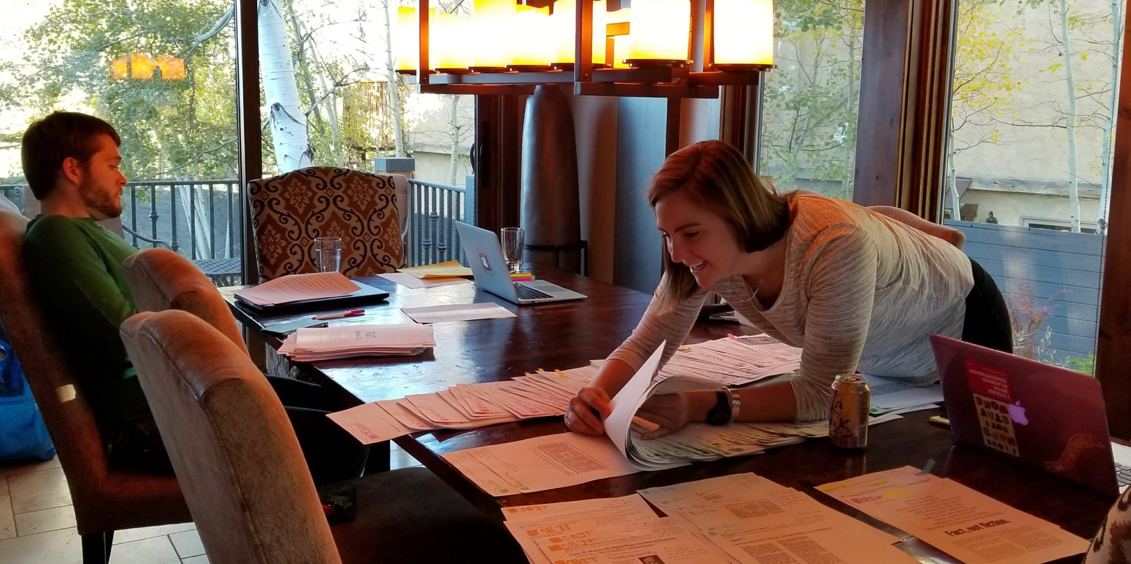
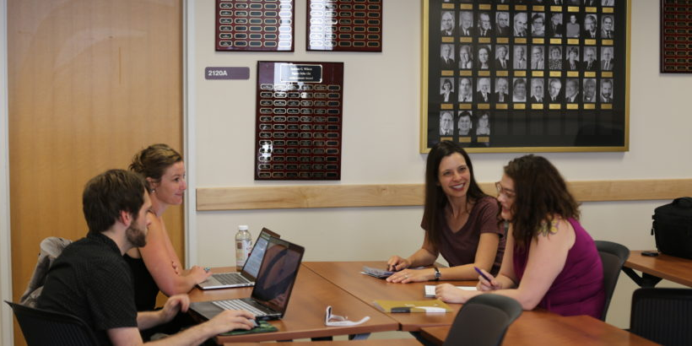
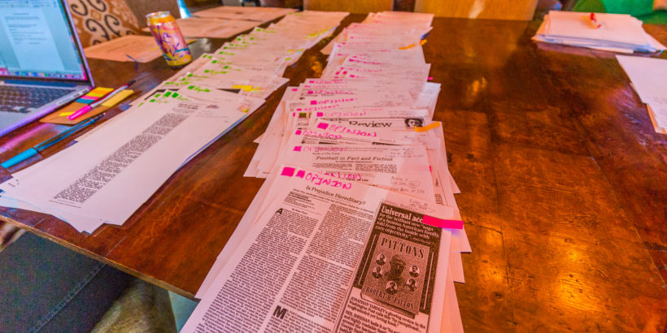
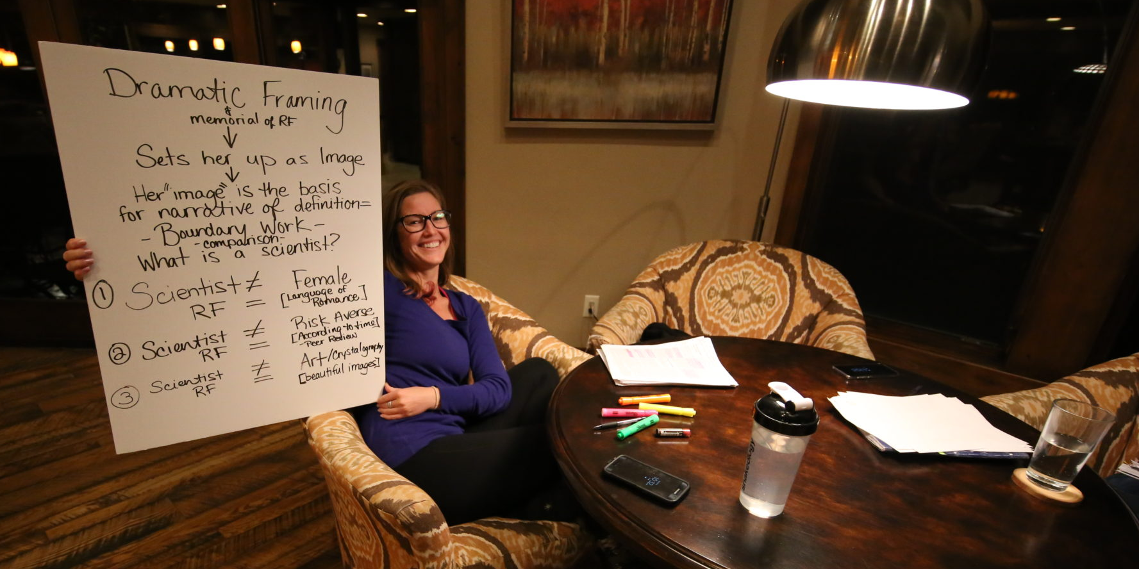
Rhetorical Analysis of the Data

Slide 8
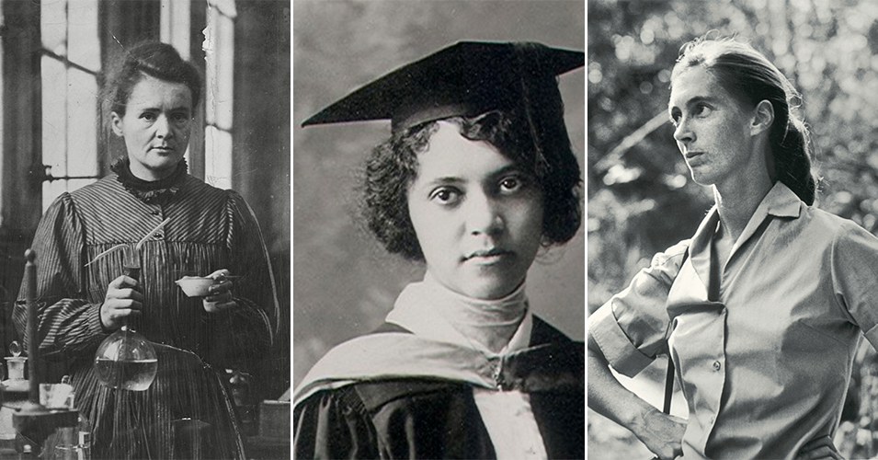
Narratives of Professional Socialization
Boundary-work
Who is a scientist?
How does one demonstrate scientific elitism?
Rosalind Franklin was narrativized across these Nature pieces in ways that designated her as just outside elite science.
Notes:
Individual clicks for bullet points

Slide 9
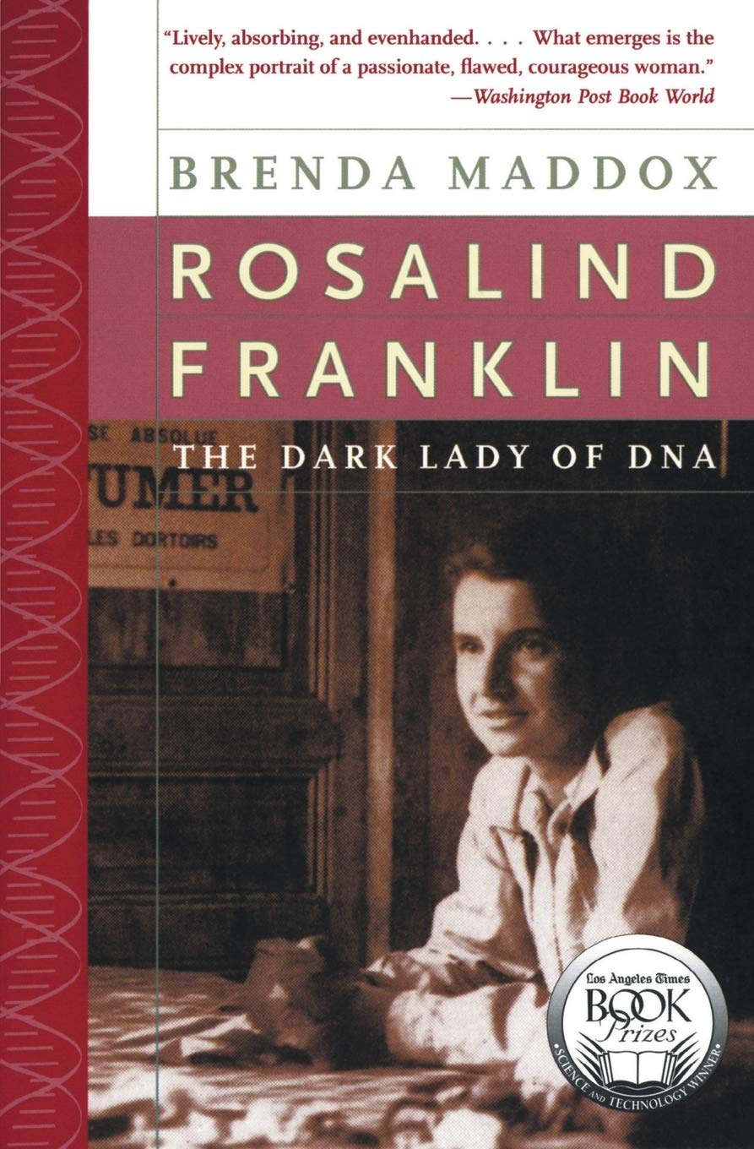
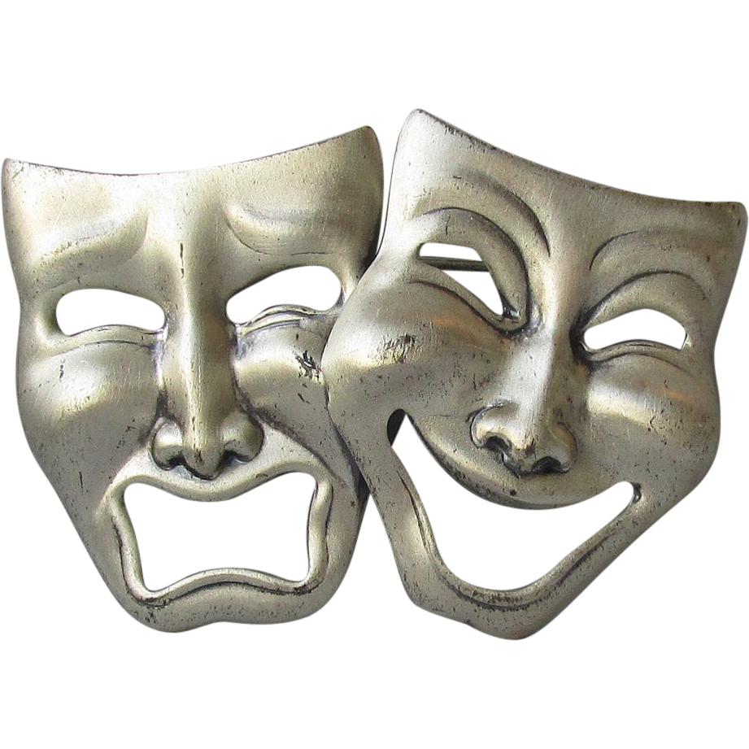
A Dramatic Telling
Witch
Heroine
Feminist icon

Slide 10
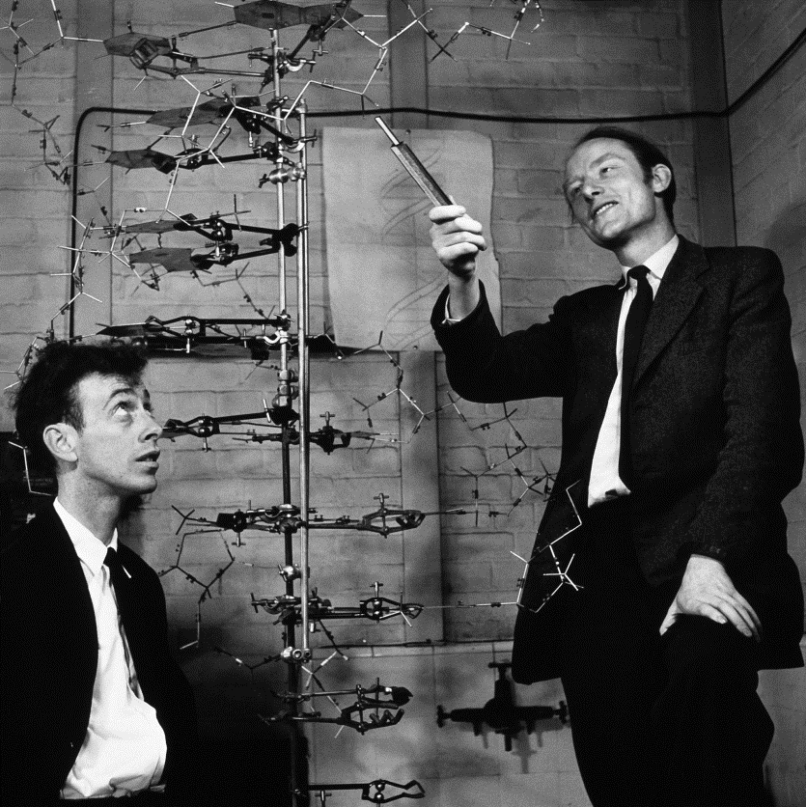
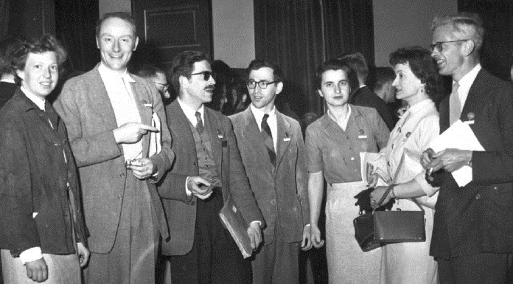
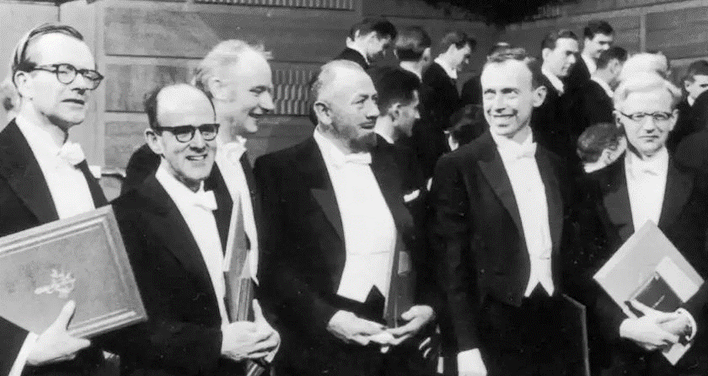
Celebrating Scientists for Intuition and Collaboration

Slide 11
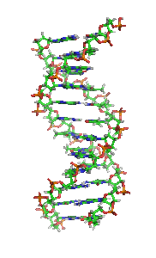
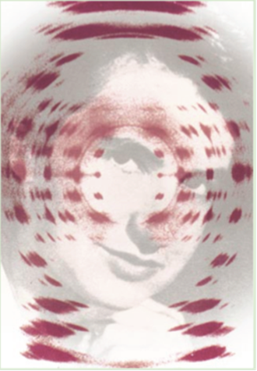
The Art of Crystallography

Slide 12
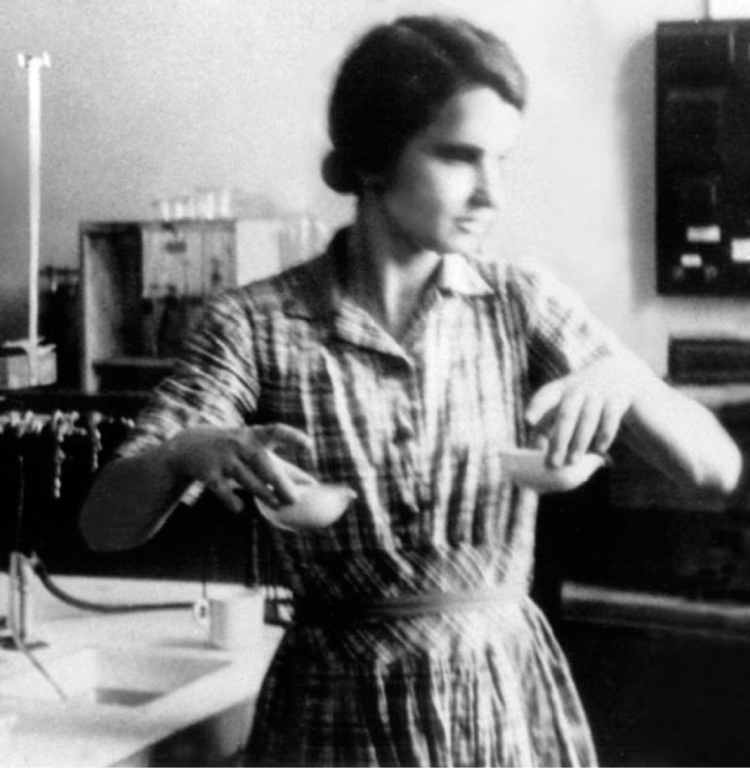
Rosalind Franklin’s Legacy
Explore the narratives that have circulated about her and consider how they function in professional and lay communities.
Boundary-work is an ongoing process that can and does change.
Remember her scientific contributions to DNA, but also to the study of coal and tobacco mosaic virus.
Notes:
Individual clicks for bullet points

Slide 13
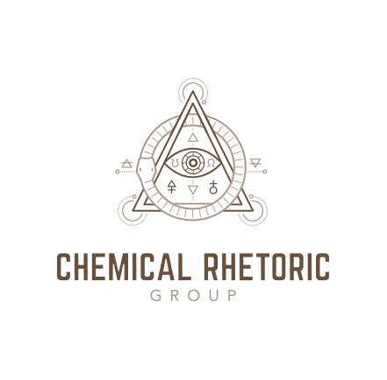
For Continued Reading:
Robin E. Jensen, Melissa M. Parks, Benjamin W. Mann, Kourtney Maison, &
Madison A. Krall. (2019). Mapping Nature’s scientist: The posthumous
demarcation of Rosalind Franklin’s crystallographic data, Quarterly Journal of Speech, 105: 3, 297-318.

Slide 14
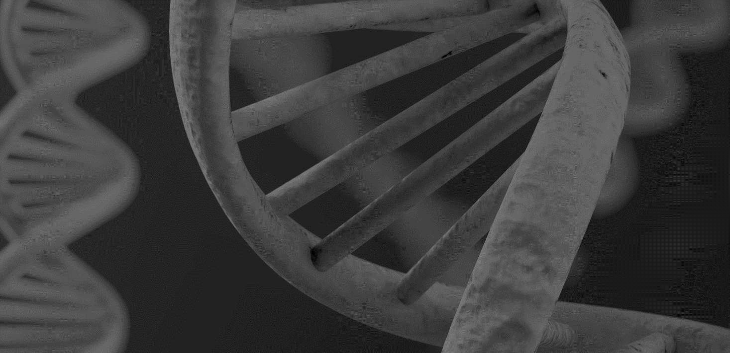
Thank you!
r.e.jensen@utah.edu robinejensen.com

